Slide 1
Supervised Learning with Neural Networks

Slide 2
Supervised Learning
Input (x) | Output (y) | Application
Home features | Price | Real Estate
Ad, user info | Click on ad? (0/1) | Online Advertising
Image | Object (1,…,1000) | Photo tagging
Audio | Text transcript | Speech recognition
English | Chinese | Machine translation
Image, Radar info | Position of other cars | Autonomous driving

Slide 3
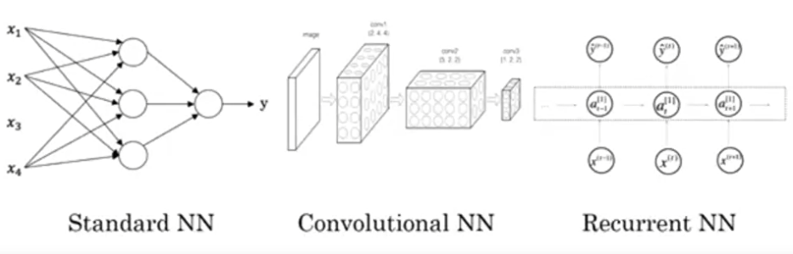
Neural Networks examples

Slide 4
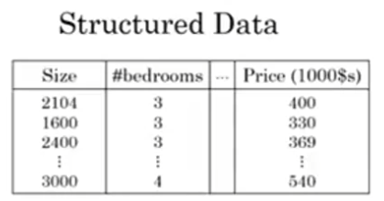
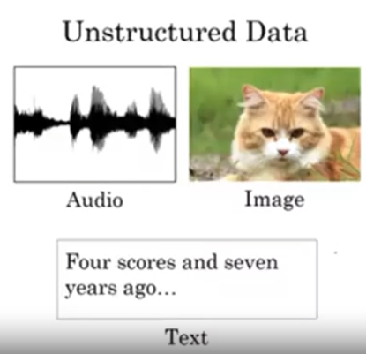
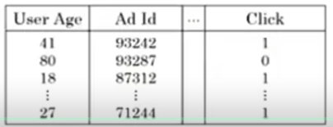
Supervised Learning

Slide 5
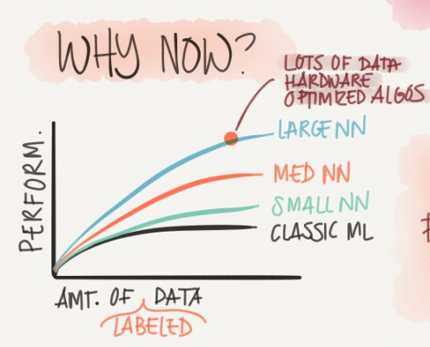
Scale drives deep learning progress

Slide 6
